Slide 1
DA Project 2 - TSP
Class 17, Group 5

Slide 2
Introduction
This project consists of a simulation of the famous Travelling Salesperson Problem
This problem consists of finding the minimal Hamiltonean cycle, i.e., given a set of nodes, go through each node once and only once and then return to the starting one
In order to solve said problem, we implemented a graph, which will soon be described
Group members: Duarte Assunção up202208319 33.(3)% Pedro Gorobey up202210292 33.(3)% Lucas Bessa up202208396 33.(3)%

Slide 3
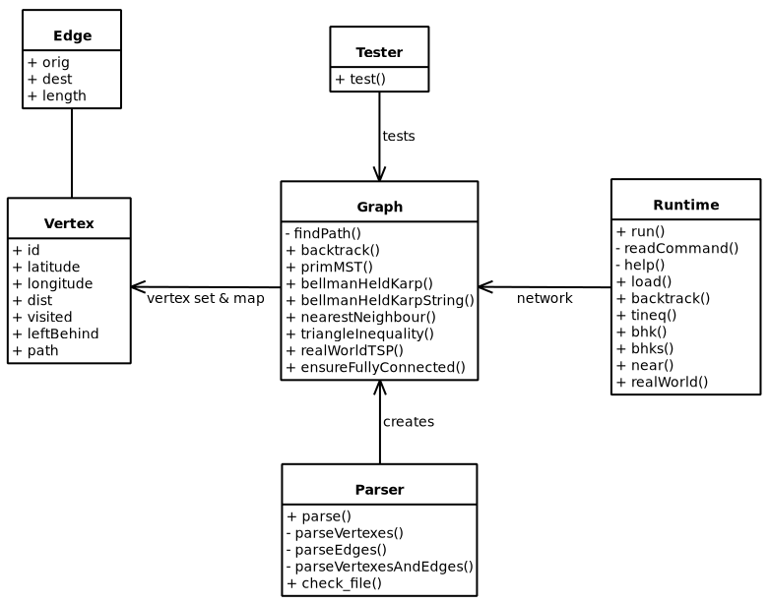
How the Graph Works
The Graph is a very basic one, consisting of nodes (vertexes) connected by undirected weighted edges
In the diagram class, each class is in the files with the same name, one ending with .cpp and the other with .hpp

Slide 4
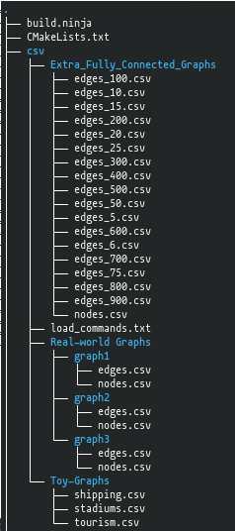
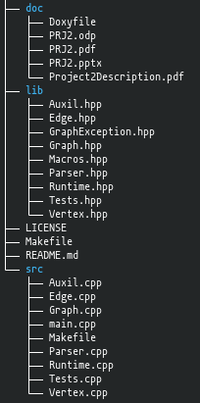
File Structure
csv/ - CSV files with Graph data
doc/ - Documentation folder
lib/ - Header files
src/ - Source files
build.ninja - Compilation file
CMakeLists.txt - Compilation file
Doxyfile - Documentation file
LICENSE - The Unlicense
Makefile - Compilation file
README.md - Project description

Slide 5
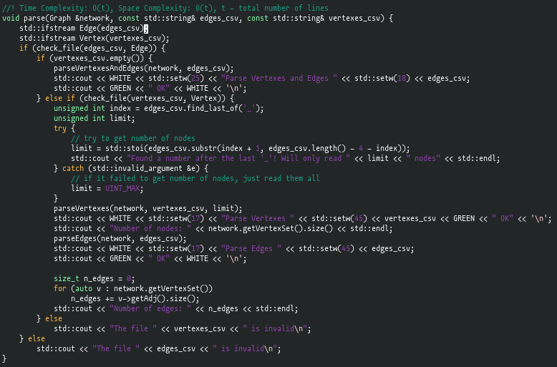
Parsing (1/2)
This function is called when the user loads the graphs. For more information on this loading, please consult the README.md file.

Slide 6
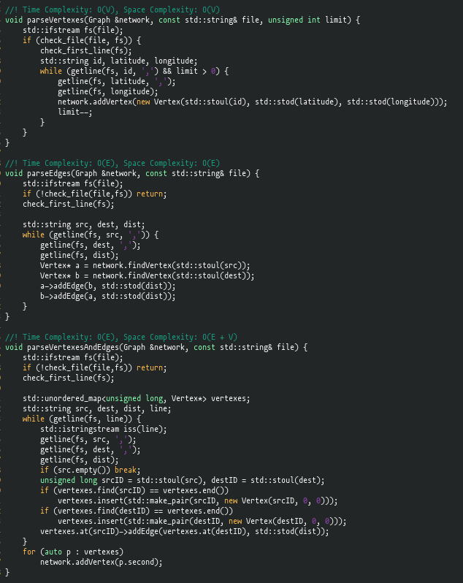
Parsing (2/2)
This fetches the data from the respective CSV file and stores it in temporary variables used to create the Vertex
A parsing function might execute solo (if both edges and nodes are derived from the same file) or in conjunction with another one

Slide 7
Vertex
Serves as a point in the graph
Used as pointers throughout the project
Methods consist of getters, setters and addition/removal of Edges
The latitude and longitude are used to compute the point’s distance to another one if the corresponding edge isn’t given
Check the Doxygen Documentation for all the attributes and methods

Slide 8
Edge
Serves as roads / connections between two points
The length is the distance between the two points
Also used as pointers
Check the Doxygen Documentation for all the attributes and methods

Slide 9
Graph (1/3)
Simulated network or map
It is composed by a vector containing all the vertexes, while edges are represented as adjancency lists in each vertex
The Graph contains various algorithms to solve the TSP
The unordered maps are useful to find certain vertexes
The methods range from getters/setters to max-flow algorithms
Check the Doxygen Documentation for all the attributes and methods

Slide 10
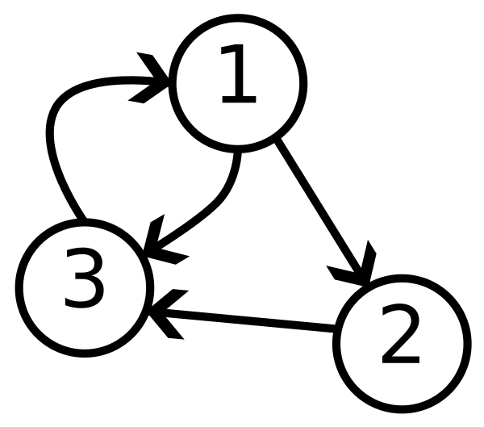
Graph (2/3)
Unless otherwise stated, all edges are undirected
The graph works like this (over-simplified):

Slide 11
Graph (3/3)
Alongside the vertexSet, the Graph also contains an unordered map of ID to Vertex
This helps with vertex and edge searches
Functions which help certain algorithms but are not intended to execute on their own are private or in the Auxil files instead

Slide 12
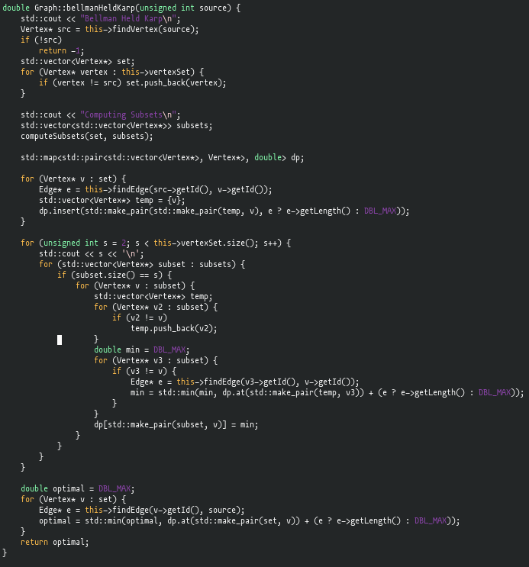
Bellman-Held-Karp
Dynamic Programming
Currently the most efficient algorithm to solve TSP, with time complexity O(n³2^{n})
Requires computation of subsets
As unordered maps don’t support hashes of vectors of custom objects, a simple map was used, which lead to a complexity of O(n³2^{n})

Slide 13
Bellman-Held-Karp String Variation
Also Dynamic Programming
This variation uses less memory and only strings
However, it is slower due to the various find-erase it executes
As unordered maps support hashing of strings, the time complexity is slightly smaller: O(n²2^{n})

Slide 14
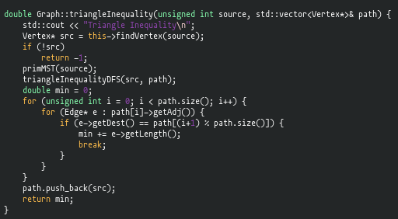
Triangle Inequality
Any side of the triangle is always smaller than the sum of the other two
This means a directed path between two points , if it exists, is always the smallest one
This algorithm uses DFS and tree traversal
Time Complexity: O(V * logV + E)

Slide 15
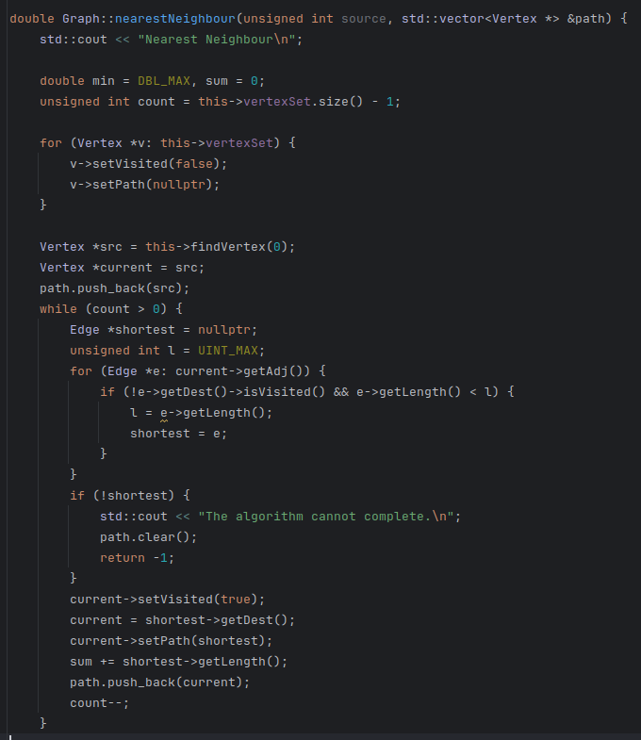
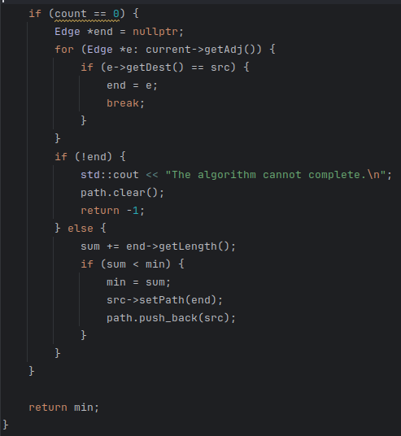
Nearest Neighbour
For each outgoing edge, it selects the smallest one and proceeds forward
It uses this approach for all vertexes, starting on all vertexes
It yields a fairly good solution, although there are special cases where it can yield the worst solution
Complexity: O(V * (V + E))

Slide 16
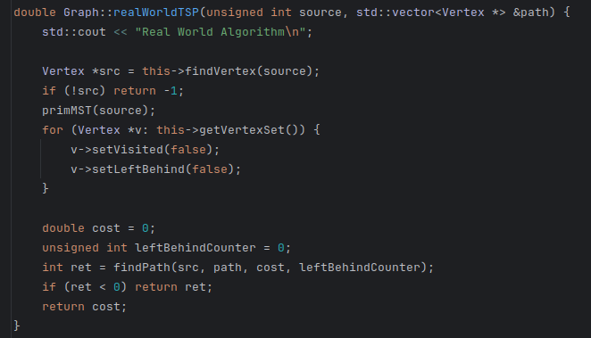
Real World Graphs TSP Algorithm
This is a tweaked version of the 2-approximation algorithm to work on real world graphs
First, we compute the MST of the graph and, then, we try to compute a tweaked version of the pre-order walk of the, as you can see on the next slide
This tweak consists of, when we encounter a vertex that cannot go further in the pre-order walk, we leave it behind (not including in the path) in the hope of being able to return there in the future
Complexity: O(V * logV + E)

Slide 17
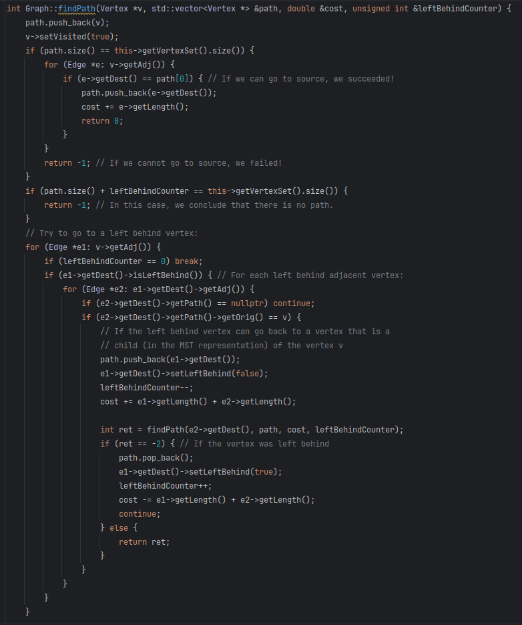
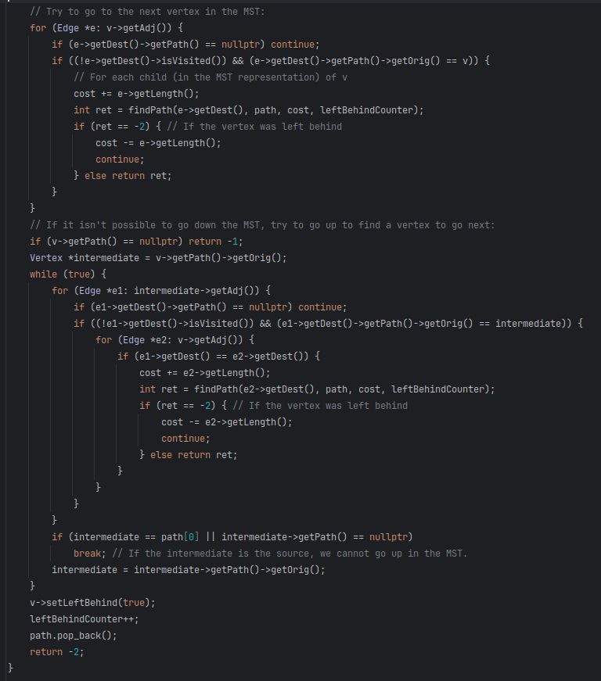
Find Path in MST
This is a recursive function that tries to find which vertex to go next
When a said vertex A is left behind, and, in the future, we manage to go from a said vertex B to A and back to a child (in the MST representation) of B, we do it
Complexity: O(V + E)

Slide 18
User Interface (1/2)
We developed an interface to allow the user to easily interact with the Network.
A menu with the valid options appears and the user can type either the option number or the option name followed by its arguments, if required.
First, you need to load the desired graph to the program, using the option 0 (or load) followed by the path to the edges and (optionally) vertexes files.
You can, then, execute the provided TSP algorithms.

Slide 19
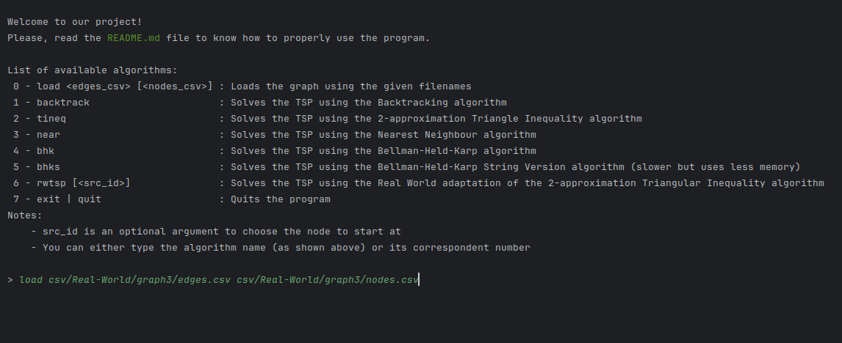
User Interface (2/2)

Slide 20
Bibliography
Slide 3:https://upload.wikimedia.org/wikipedia/commons/1/15/3_node_Directed_graph.png?20230623211051
Font used (by Nerd Fonts, clicking here will download the font): https://github.com/ryanoasis/nerd-fonts/releases/download/v3.1.1/Hack.zip
All other images and descriptions were made by us

